Slide 1
SENTINEL-NIDS
A Machine Learning-Based NIDS for
Cybersecurity Threat Detection

Slide 2
INTRODUCTION
SENTINEL is a Network Intrusion Detection System (NIDS) that utilizes machine learning to monitor and classify network traffic effectively.

Slide 3
01
OBJECTIVE
DETECTS AND CLASSIFIES NETWORK TRAFFIC
The primary objective of the project is to develop a Network Intrusion Detection System (NIDS) that can analyze network traffic in real-time.
Using machine learning algorithms, the system aims to identify and classify traffic as either normal or anomalous.

Slide 4
UTILIZING MACHINE LEARNING
The project leverages machine learning to enhance the detection capabilities of the NIDS.
By training a model on historical network traffic data, the system learns to identify specific patterns indicative of normal versus anomalous behavior.
This continuous learning process improves detection accuracy over time and helps adapt to evolving network threats.

Slide 5
TECHNOLOGIES
Frontend (User Interface - React & Tailwind CSS)
React.js – Component-based UI development.
Tailwind CSS – Utility-first CSS framework for styling.
Axios – Handles API requests to the backend.
Backend (Threat Detection API - Flask)
Flask – Python web framework for API development.
Scikit-learn – Machine learning for threat classification.
Pandas & NumPy – Data handling and preprocessing.
02
SYSTEM ARCHITECTURE

Slide 6
MODEL TRAINING
Algorithm: RandomForestClassifier from sklearn.ensemble
Number of Trees (n_estimators): 100 => No. of Decision Tress used.
Random State: 42 (for reproducibility)
Training Data: The dataset is preprocessed with categorical encoding (LabelEncoder) and feature scaling (StandardScaler).
Prediction & Evaluation: The model is trained on 80% of the data and evaluated on the remaining 20% and evaluated using accuracy score, classification report, and a confusion matrix.

Slide 7
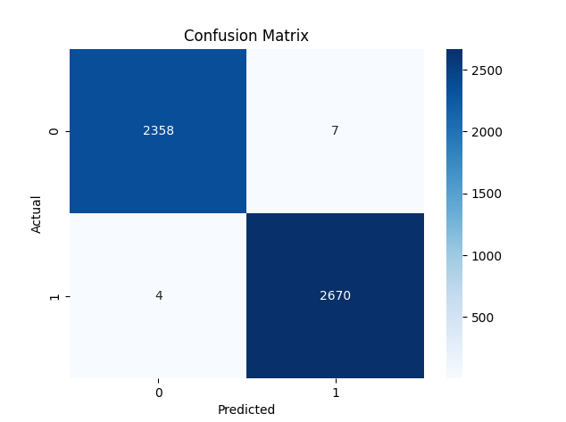
MODEL TRAINING RESULTS
Accuracy: 99.78%
Out of 5039 validation samples, only a very small number of predictions were incorrect.
Precision, Recall, and F1-score:
Precision, Recall, and F1-score: All at 1.00 (or close)
Balanced Classes
Both classes (0 and 1) have a relatively balanced number of samples (2365 vs. 2674), so the model isn’t biased toward one class.
TN
FP
FN
TP

Slide 8
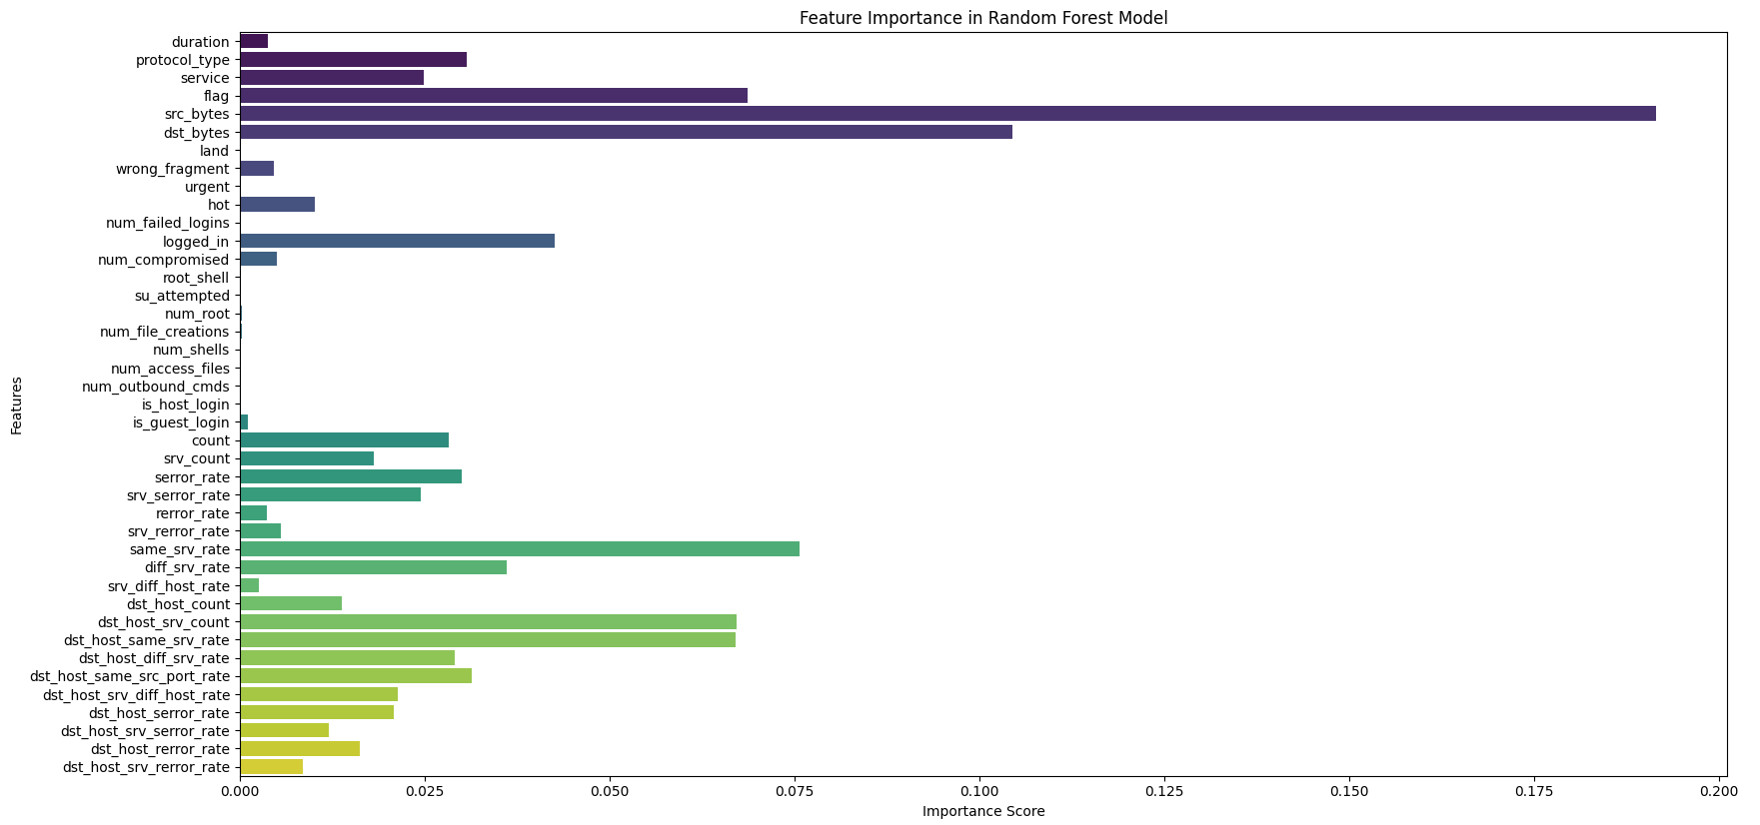

Slide 9
THANK YOU

Slide 10
Presented by
ARKADIP DAS

